Slide 1








A. P. Shah Institute of Technology, Thane
Department of Computer Engineering
DeFinance
Name: Sanket Naikwadi Roll no: 113 Division: B
Name: Aman Pandey Roll no: 125 Division: B
Name: Chinmay Patil Roll no: 135 Division: B
Name: Hrugved Parab Roll no: 128 Division: B
Under the Guidance of: Prof. Pranali S. Patil

Slide 2
DeFinance: Decentralised Lending and Borrowing of Digital Assets

Slide 3
Introduction
What is Blockchain ?
What is DeFinance ?
Imagine a digital record book shared across a vast network of computers. This record book, continuously replicated and updated. It securely stores information in blocks, chronologically chained together using cryptography. This structure makes tampering with data nearly impossible, fostering trust and transparency in transactions. Blockchain's potential extends beyond cryptocurrencies, offering a secure way to track ownership, manage supply chains, and conduct many other digital interactions.
Forget traditional banks!
DeFinance is a decentralized application built on blockchain which allows you to borrow and lend cryptocurrencies directly to other users, cutting out the middleman. Imagine earning interest on your crypto holdings or getting a loan without a bank. DeFi offers a new way to manage your crypto and potentially earn more.

Slide 4

Problem Statement
The existing traditional financial systems often present numerous challenges and limitations in providing efficient, transparent, trustless and inclusive lending and borrowing services. As a result, the decentralized finance (DeFi) space has emerged, seeking to revolutionize the financial industry through the use of blockchain technology and smart contracts.
Exclusivity to services to certain users in traditional systems.
No Availablity of efficient & transperant solutions.
No Trustless & Decentralized platform.

Slide 5

To Develop a DeFinance Platform
To offer a Trustless and Transparent Solution
Objectives
Implement efficient and dynamic interest rates
Ensure Financial Inclusion
Improve the cost & capital efficiency
Mitigate Counterparty Risks

Slide 6
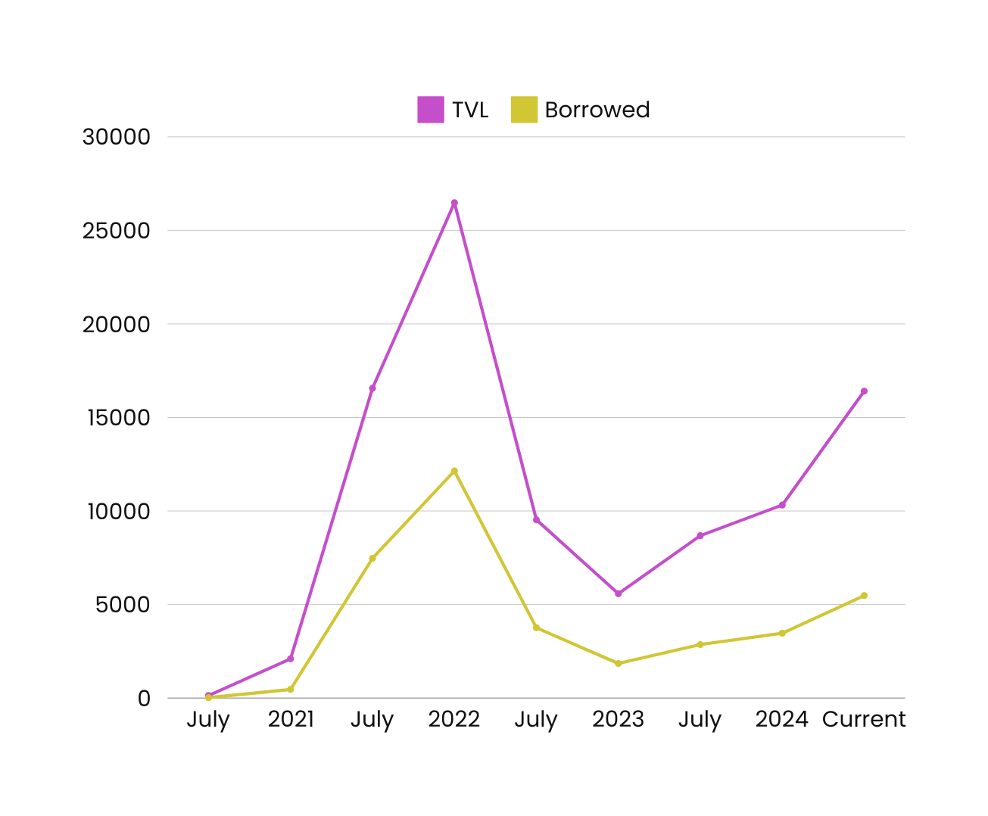
TVL and Borrowed
The chart illustrates the Total Value Locked and Borrowed in USD across various reputable DeFi platforms, with figures shown in millions of USD.

Slide 7
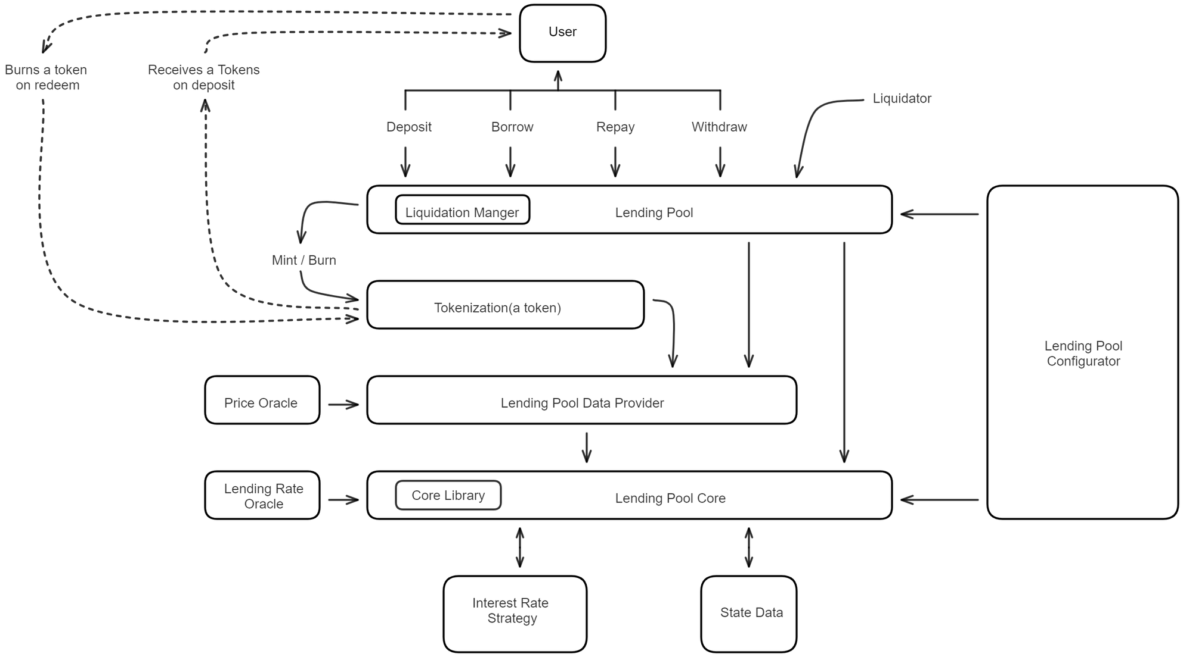
Architecture Diagram

Slide 8
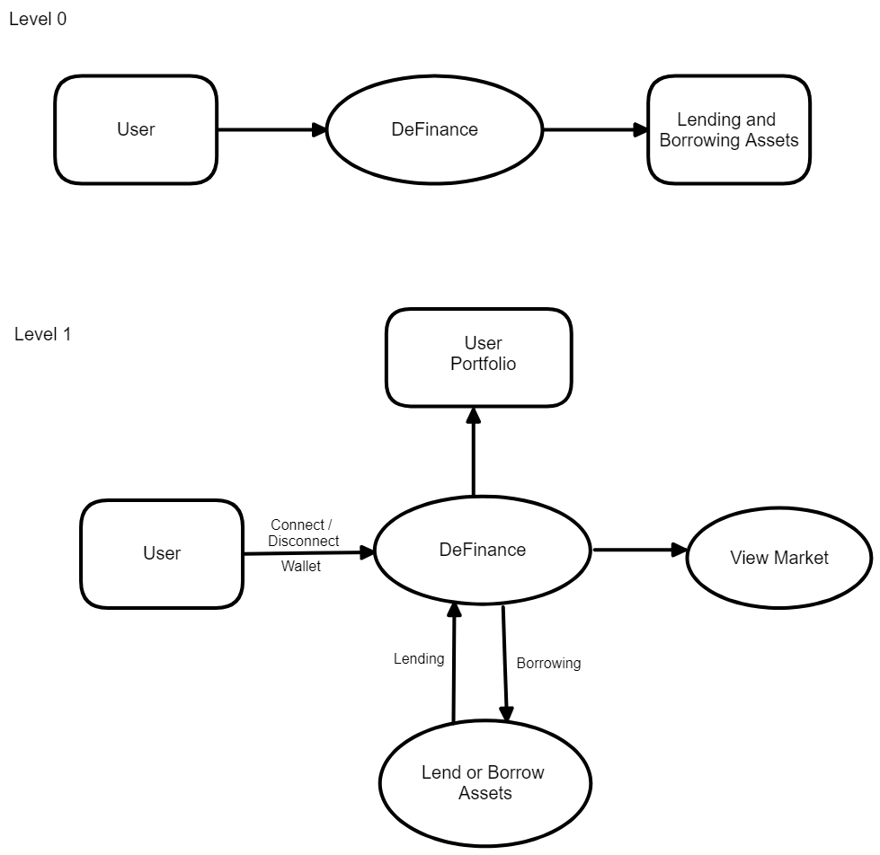
DFD Diagram

Slide 9
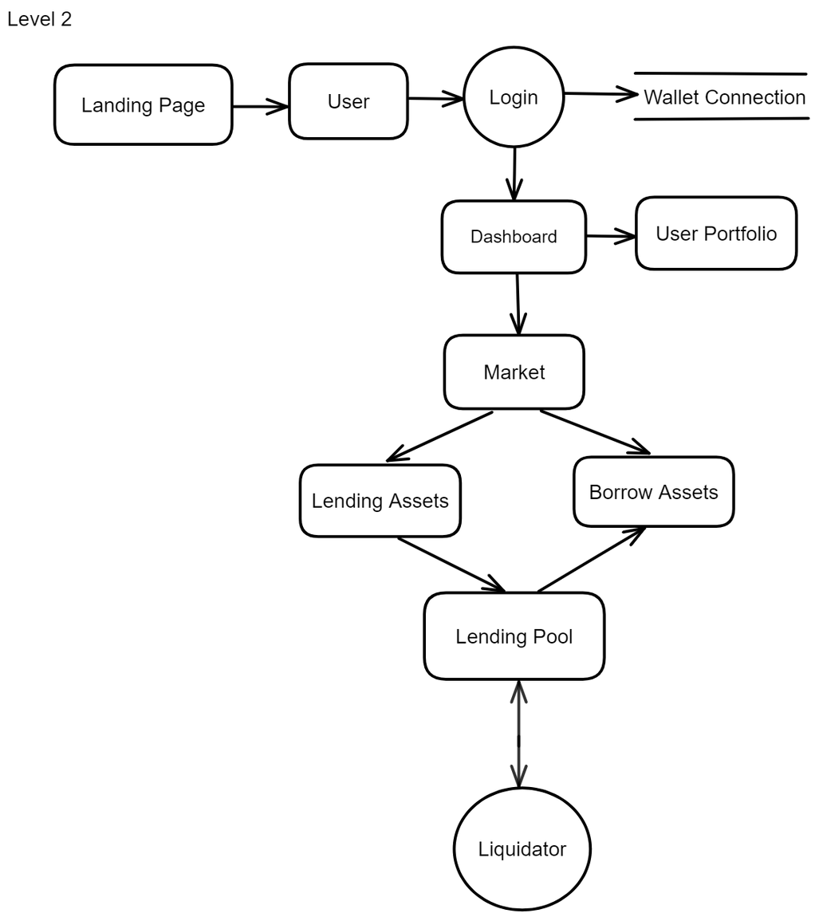
DFD Diagram

Slide 10
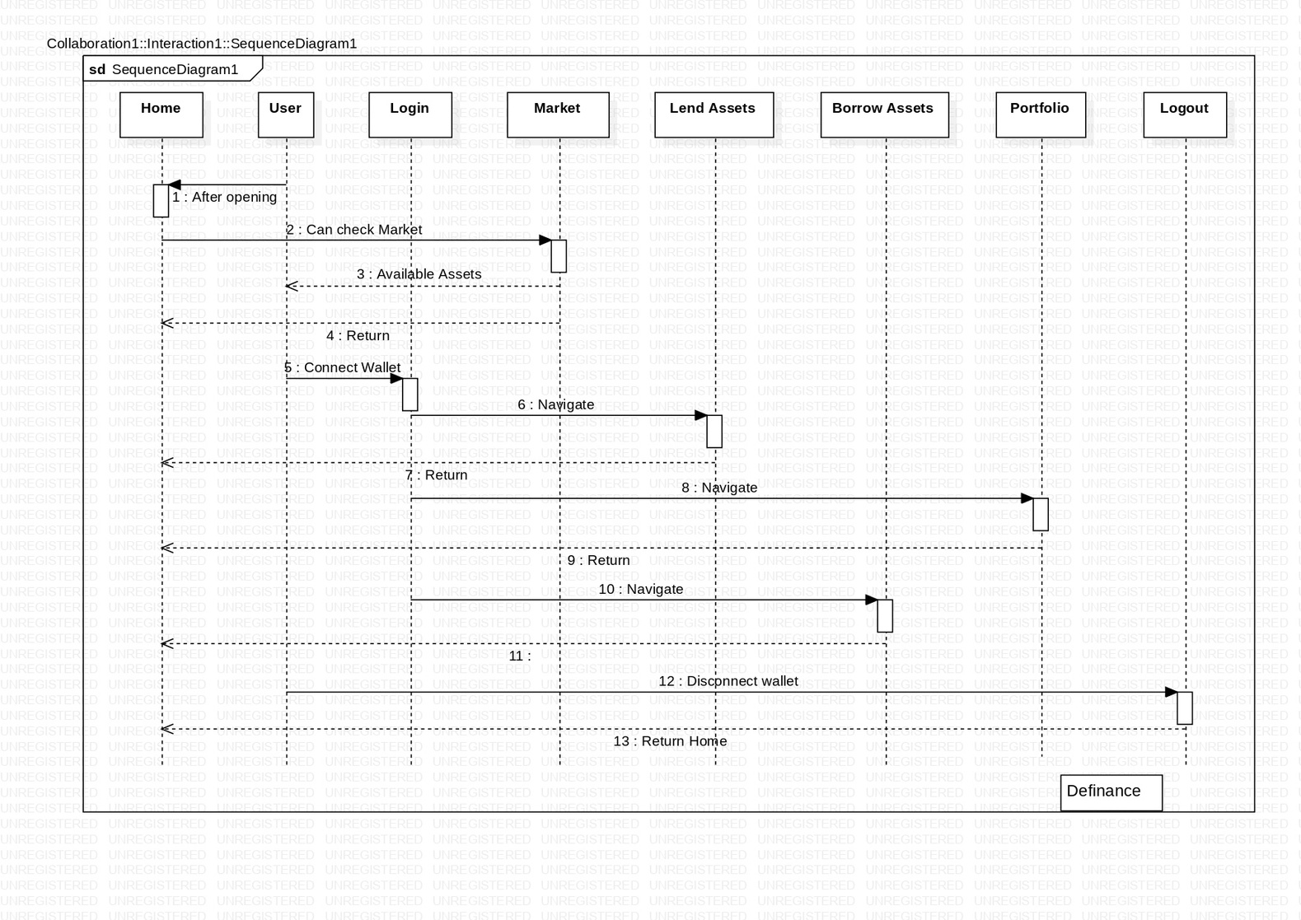
Sequence Diagram

Slide 11
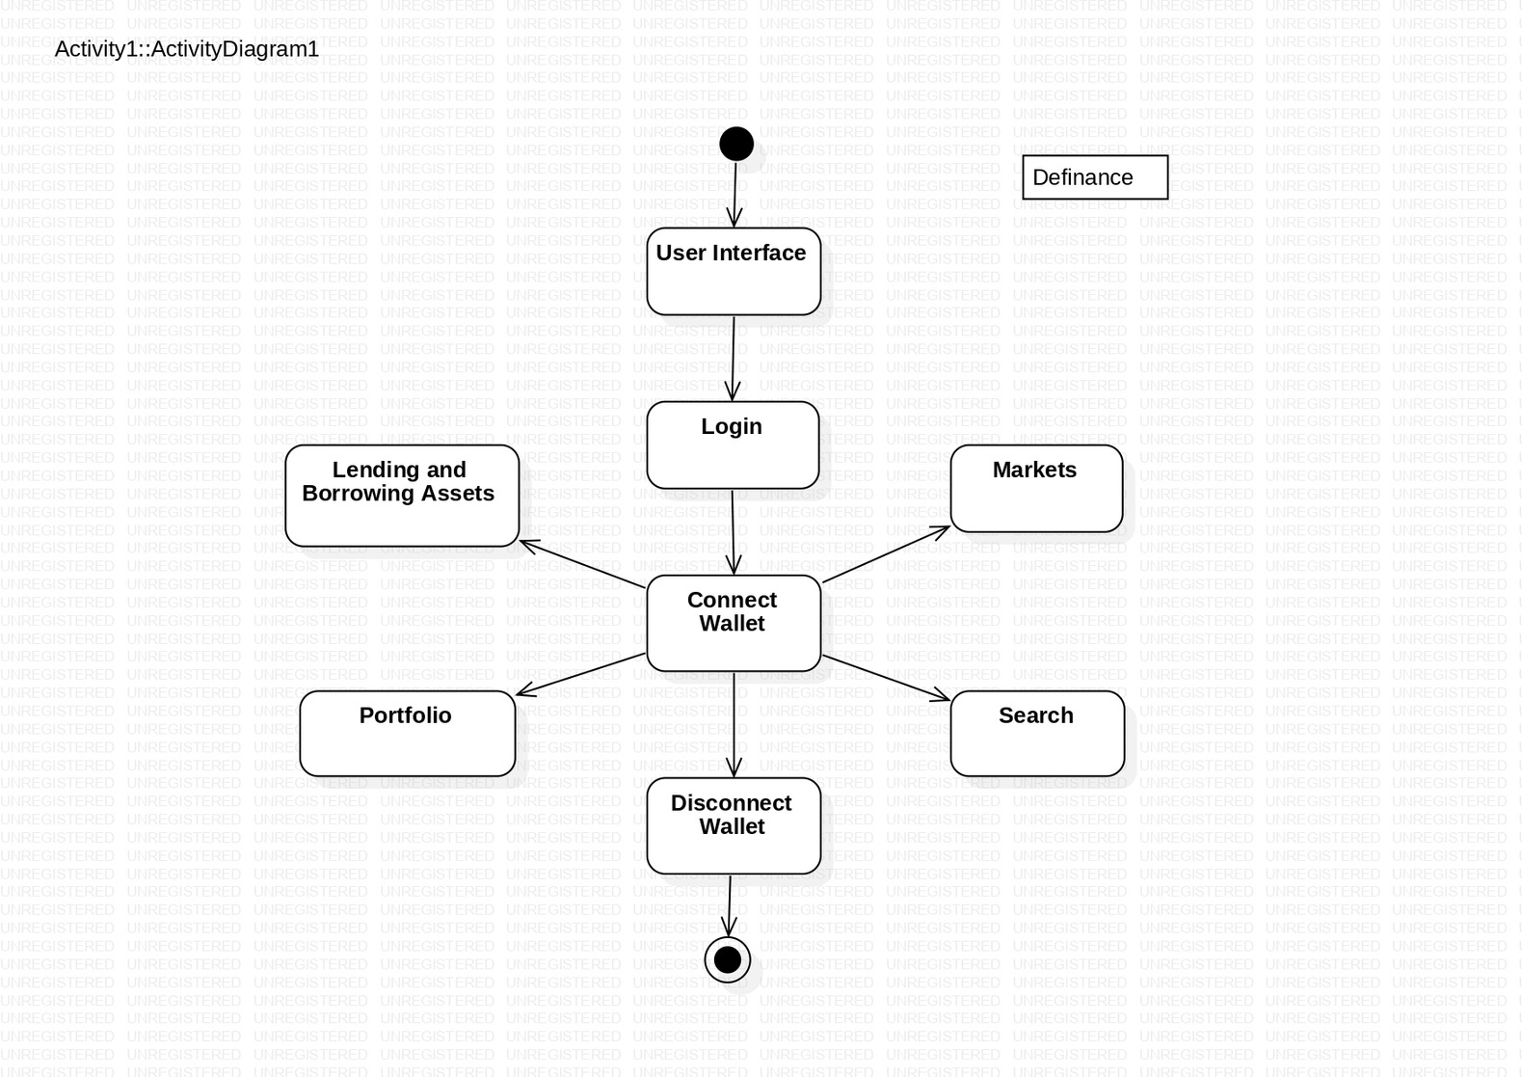
Activity Diagram

Slide 12
Thank You

